Slide 1
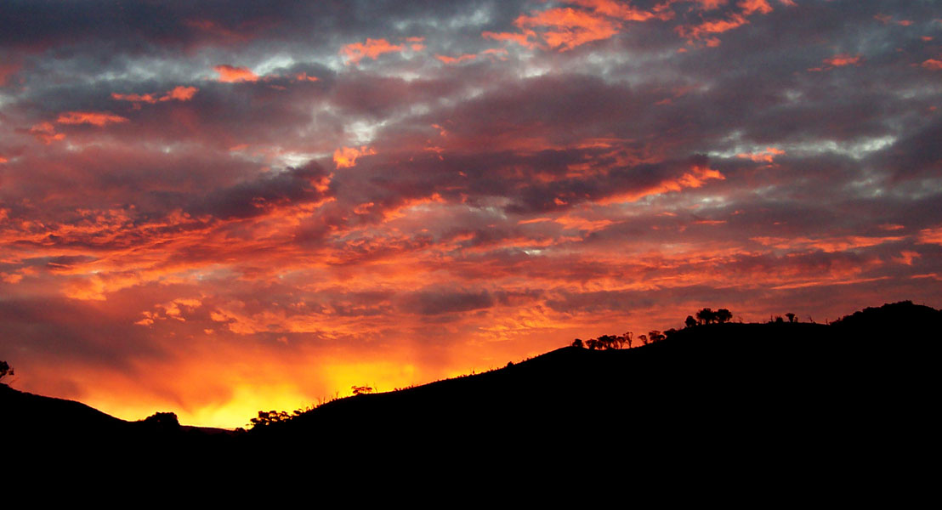
Gargunnock Community Trust
Future Priorities 2018 -2023

Slide 2
The Planning Process
What we did this year
Future Project Ideas
Ideas today and from elsewhere
Sorting out the priorities
An Action Plan?

Slide 3
What we did this Year
Concluded agreement with Foundation Scotland on the management of the Kingsburn Windfarm Fund and set up Fund Guidelines
Set up the Gargunnock Windfarm Fund Panel from village organisations, which met 4 times and approved funding for 13 projects
Received £45,350 from Falck [payment for 2 years] and allocated £30,485 [67%] to projects

Slide 4
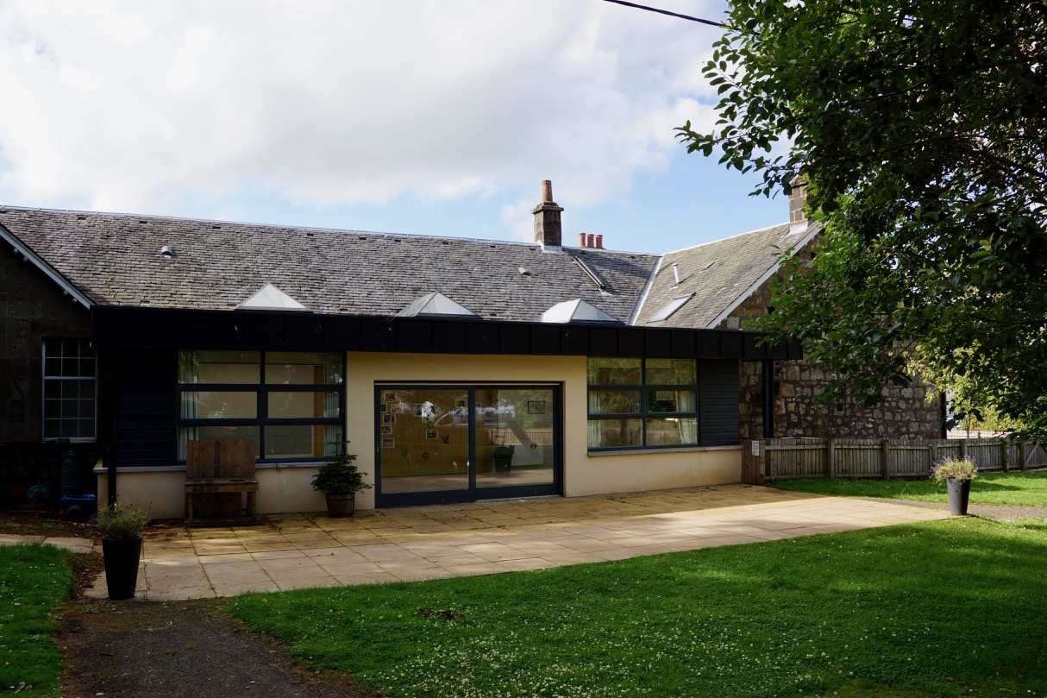
Approvals
Sinking Fund for the maintenance of the
Community Centre [£6000]
Stage Extension for
Our Local Songsters Choir [£1560]

Slide 5
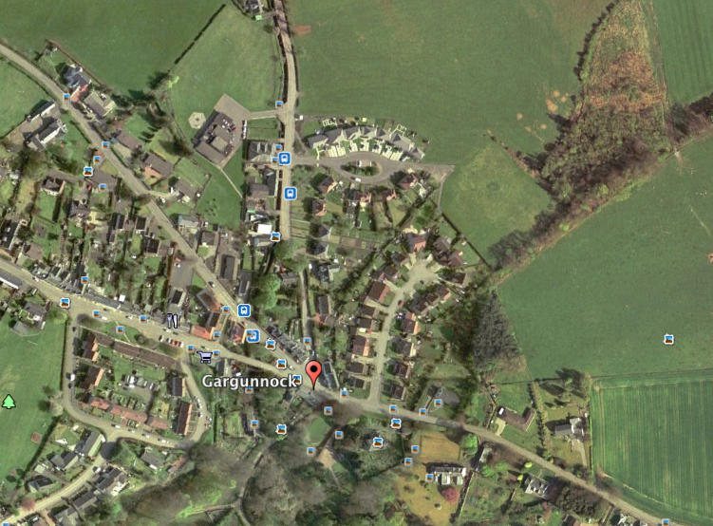
Approvals
Glebe Land
Geotech Study to assess ground conditions [£1375]

Slide 6
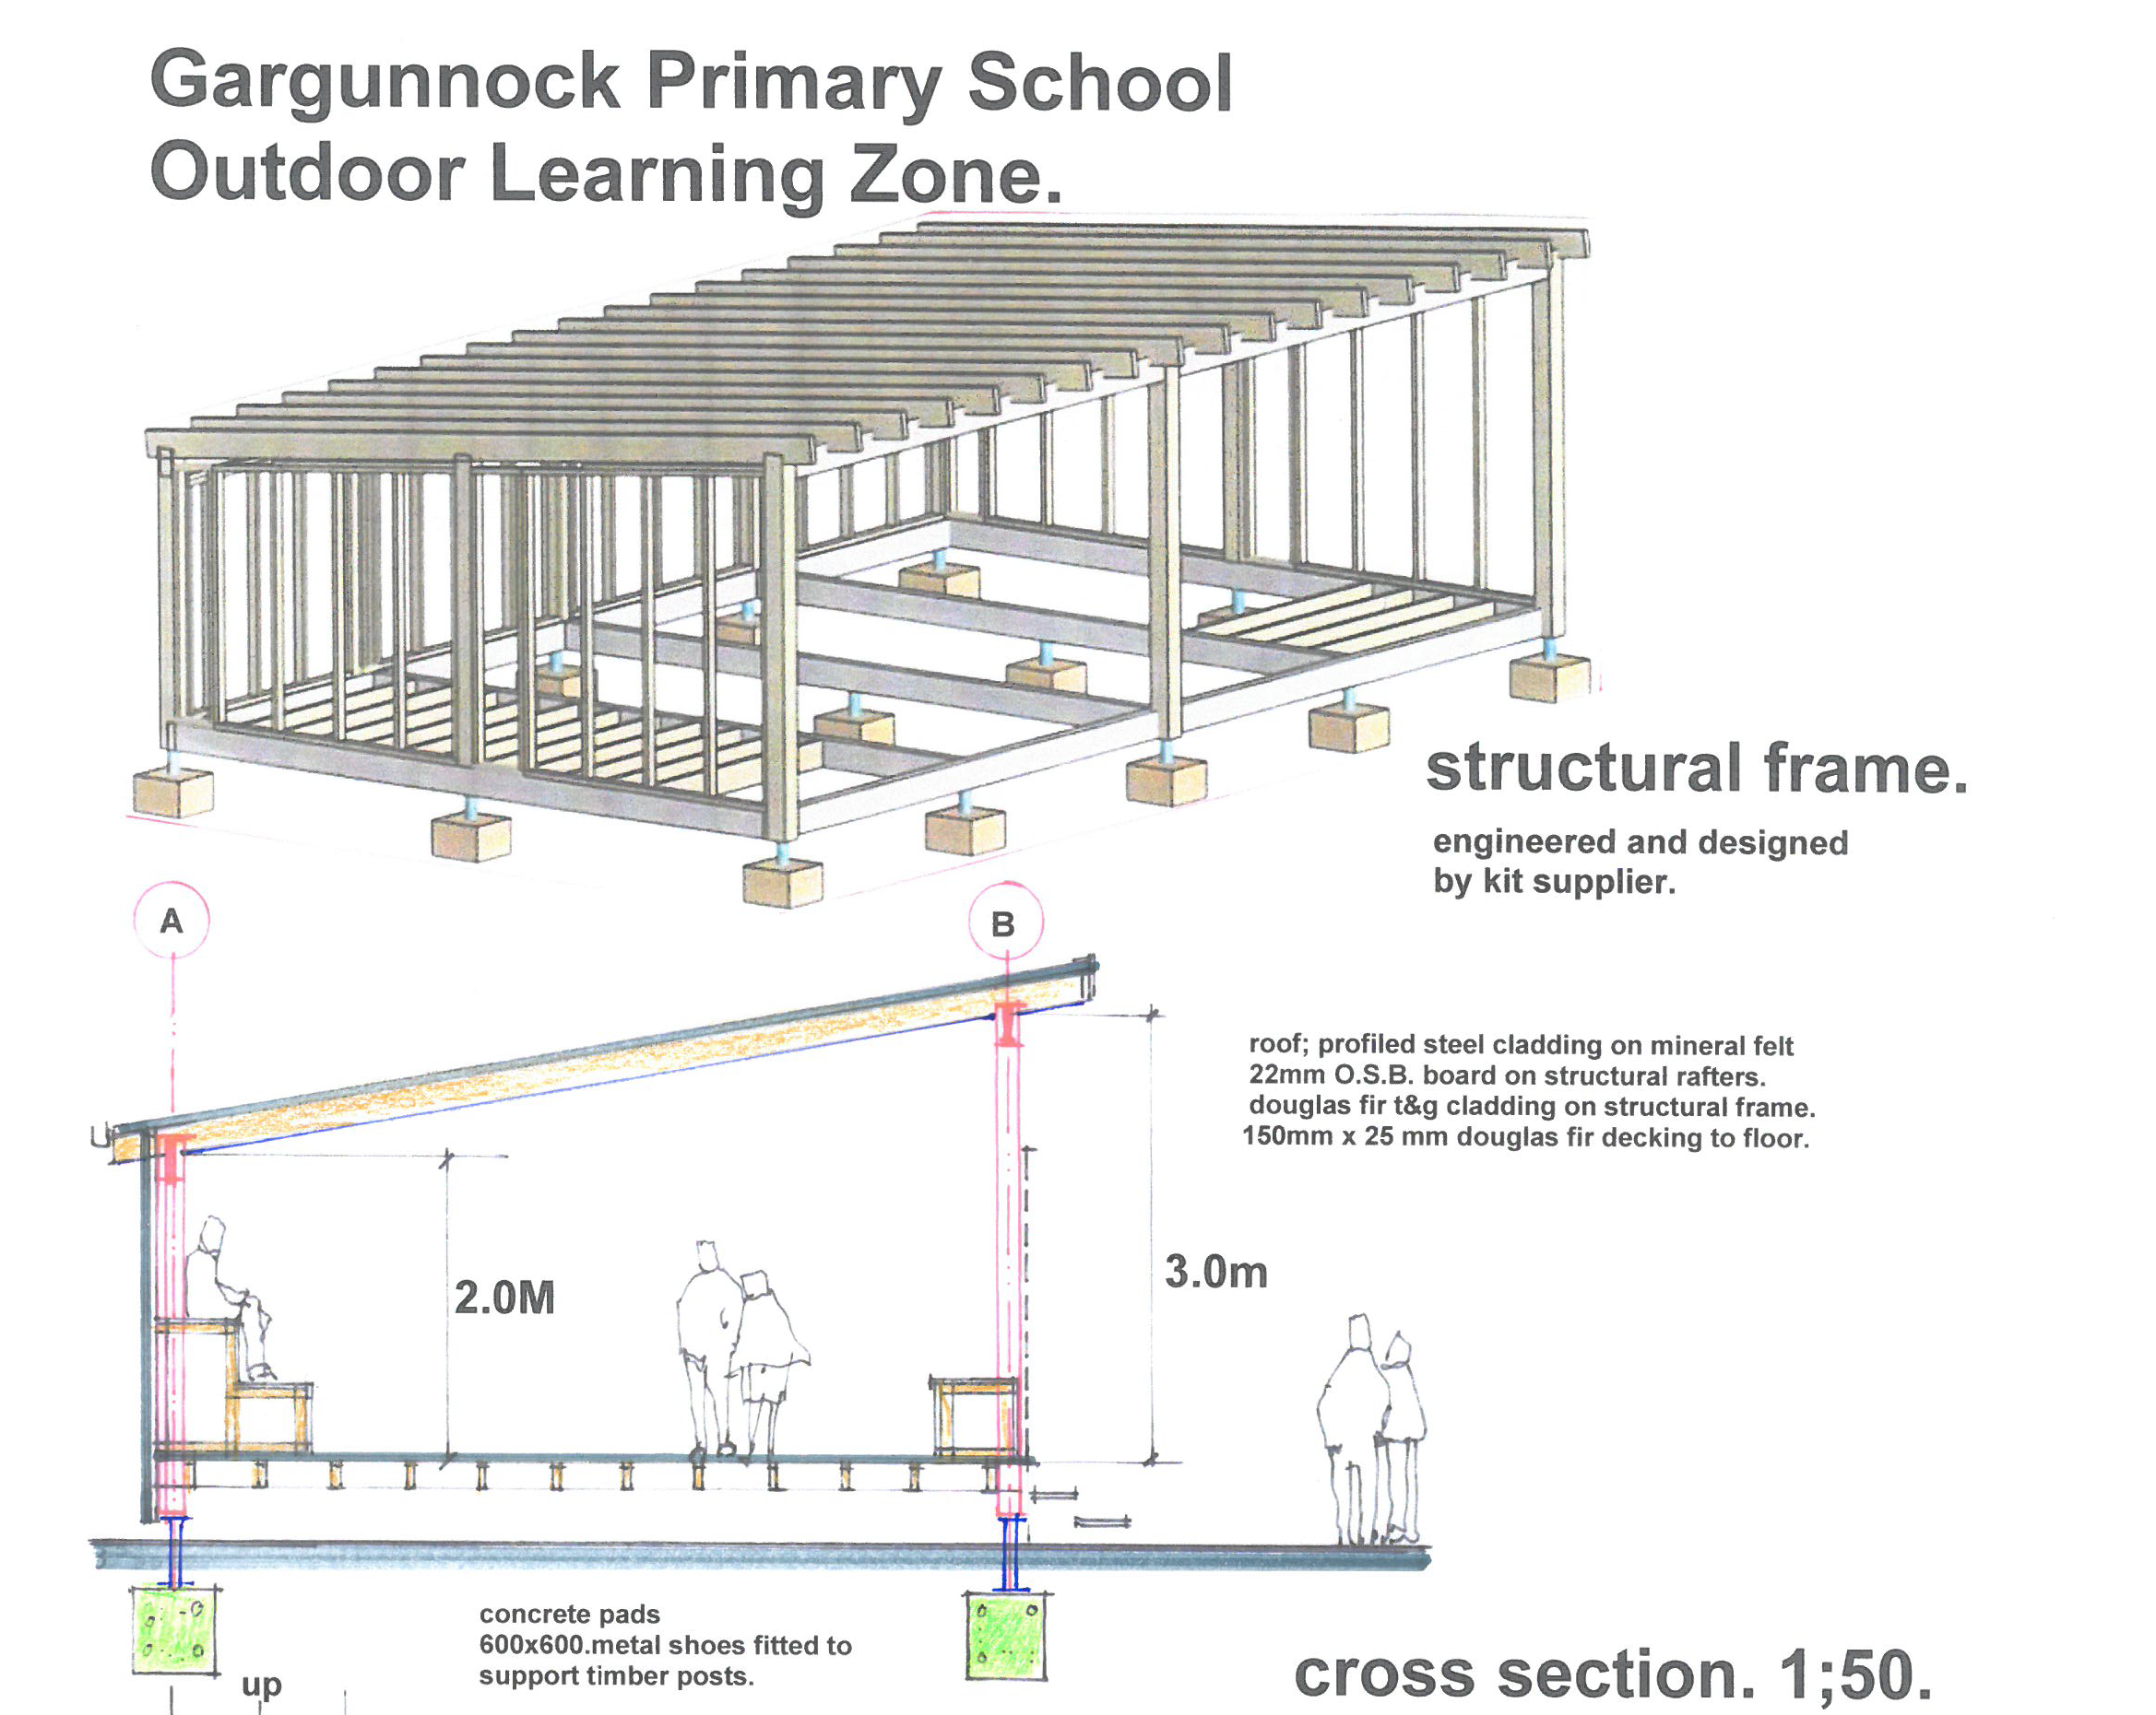
Approvals
Outdoor Learning Zone for the Parent Council [£15,000]

Slide 7
Other Approvals
After School Club
Playgroup & Toddlers
PS Book Club
Breakfast Club
Gala Committee
Old Peoples Welfare
Guides
SWRI
Footbridge Repainting
2 Large Grant Approvals [over £5000]…………totalling £21,000 [69%]
6 Major Grant Approvals [£500 - £5000]……..totalling £7,585 [25%]
5 Small Grant Approvals [up to £500]…………totalling £1,900 [ 6%]
£21,300 [70%] was spent on building related activities
£5,445 [18%] on direct people related activities
£2,063 [ 7%] on equipment
£1,675 [ 5%] on feasibility studies

Slide 8
Future Project Ideas
The Glebe Surveys 2017
Local Development Plan Consultation 2010-11
The Last Community Plan 2001
Other Current Project Ideas

Slide 9
The Glebe Geotechnical Survey
Geotechnical Survey Results
Low water and contamination risk for most uses
Strip foundations for buildings not suitable and other methods would be necessary [vibro or piling]
Not made up ground or other sources of ground gas

Slide 10
The Glebe Constraints

Slide 11
The Glebe Future Use Survey
Garden Type Uses [45%]
Wildlife Garden/Pond
Orchard/Allotments
Recreational Uses [36%]
Picnic area/grassed area/access to Lady’s Walk
Children’s Play area/multi-purpose sports pitch
Housing [19%]
Affordable/Social Housing
12 -15 units

Slide 12
Local Development Plan Consultation
Additional Social Housing
2011 Survey indicated that 63% wanted modest development [15 units]… 14% were opposed ….and 23% did not respond
Open Space Improvements
High levels of support [80-90%] for improvements to Provost Park/ amenity planting at village entrances/attention to woodland areas [eg. Glebe] and support for community orchards and allotments [76%]
Transport and Road Safety
Strong support for the development of footpaths and cycleways [96%]
Introduction of traffic calming measures [69%]
Improved off road car parking at the Community Centre [88%]

Slide 13
Community Futures Plan 2000
Community Facilities
Upgrading the Pavilion
Education and Employment
Nursery and out of school care provision
Lifelong learning centre
Environment and Access
Traffic calming and improved road safety
New footpath and cycleway routes
Better play facilities for children
Better indoor and outdoor sports facilities
Improved Community Centre
Business incubator units
Local organic horticulture
Cleaning up/improving open spaces
Community woodland
Key
Action
Areas

Slide 14
Other Current Project Ideas
Repair and improve the Beeches Walk
Develop paths and cycleways into Cambusbarron and Stirling
Provide interpretive board and viewpoint on Keir Hill
Improve setting of Fountain and improve Memorial Garden
Improve Community Centre energy efficiency [solar panels]
Provide landscaped “gateways” to the village
See also the Glebe consultation development options

Slide 15
Summary of Future Project Ideas
Education/Employment
Nursery Provision
Lifelong Learning Centre
Business Incubators
Local Horticulture [allotments?]
Education
Housing
12 Affordable Units [Glebe Survey]
15 Affordable Units [LDP Survey]
Transport/Road Safety
Village Gateways
More road safety measures?
Community Centre off-road parking
Environment/ Access
Provost Park improvements
Other improvements [eg.. Memorial Garden]
Footpath and cycleway development
Community woodland
Community Facilities
Community Centre improvements
Children’s Play Area
Multi-purpose sports facilities
Pavilion upgrade
Community cafe

Slide 16
Ideas today and from elsewhere
Good ideas from other Trusts
Gaps in local provision
New suggestions from the village

Slide 17
AGM Action Points
Short Term Actions
Construct basic Glebe Path
Medium Term Actions
Develop cycleway/footpath into Stirling
Make the Pavilion fit for purpose
Support new Bite and Blether
Improve the Beeches Path
Improve Fountain/Memorial Garden
Liaise with Kippen re Rainbows
Support more defibrillator training
Improve Provost Park
Support Heritage development[Keir Hill]
Acquire field next to Community Centre
Develop more paths around the village

